Slide 1
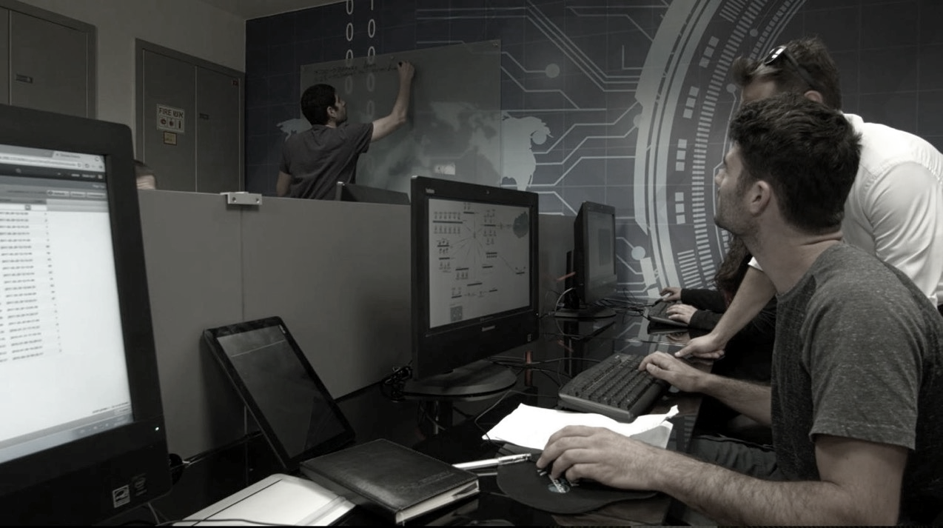

Cyberbit
The Global Leading Provider
of Cyber Range Platforms

Slide 2



About Cyberbit
Founded 2015
Employs 150
Offices in the US, Europe and Asia
Raised $70M from Charlesbank in 5/2020
Top-Tier Investors

Slide 3

OUR MISSION:
Prepare the Cyber Defenders of the World

Slide 4
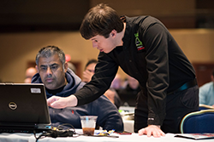
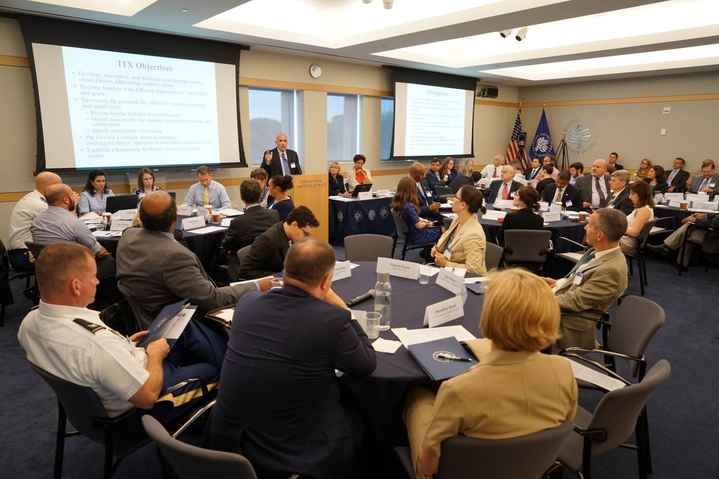
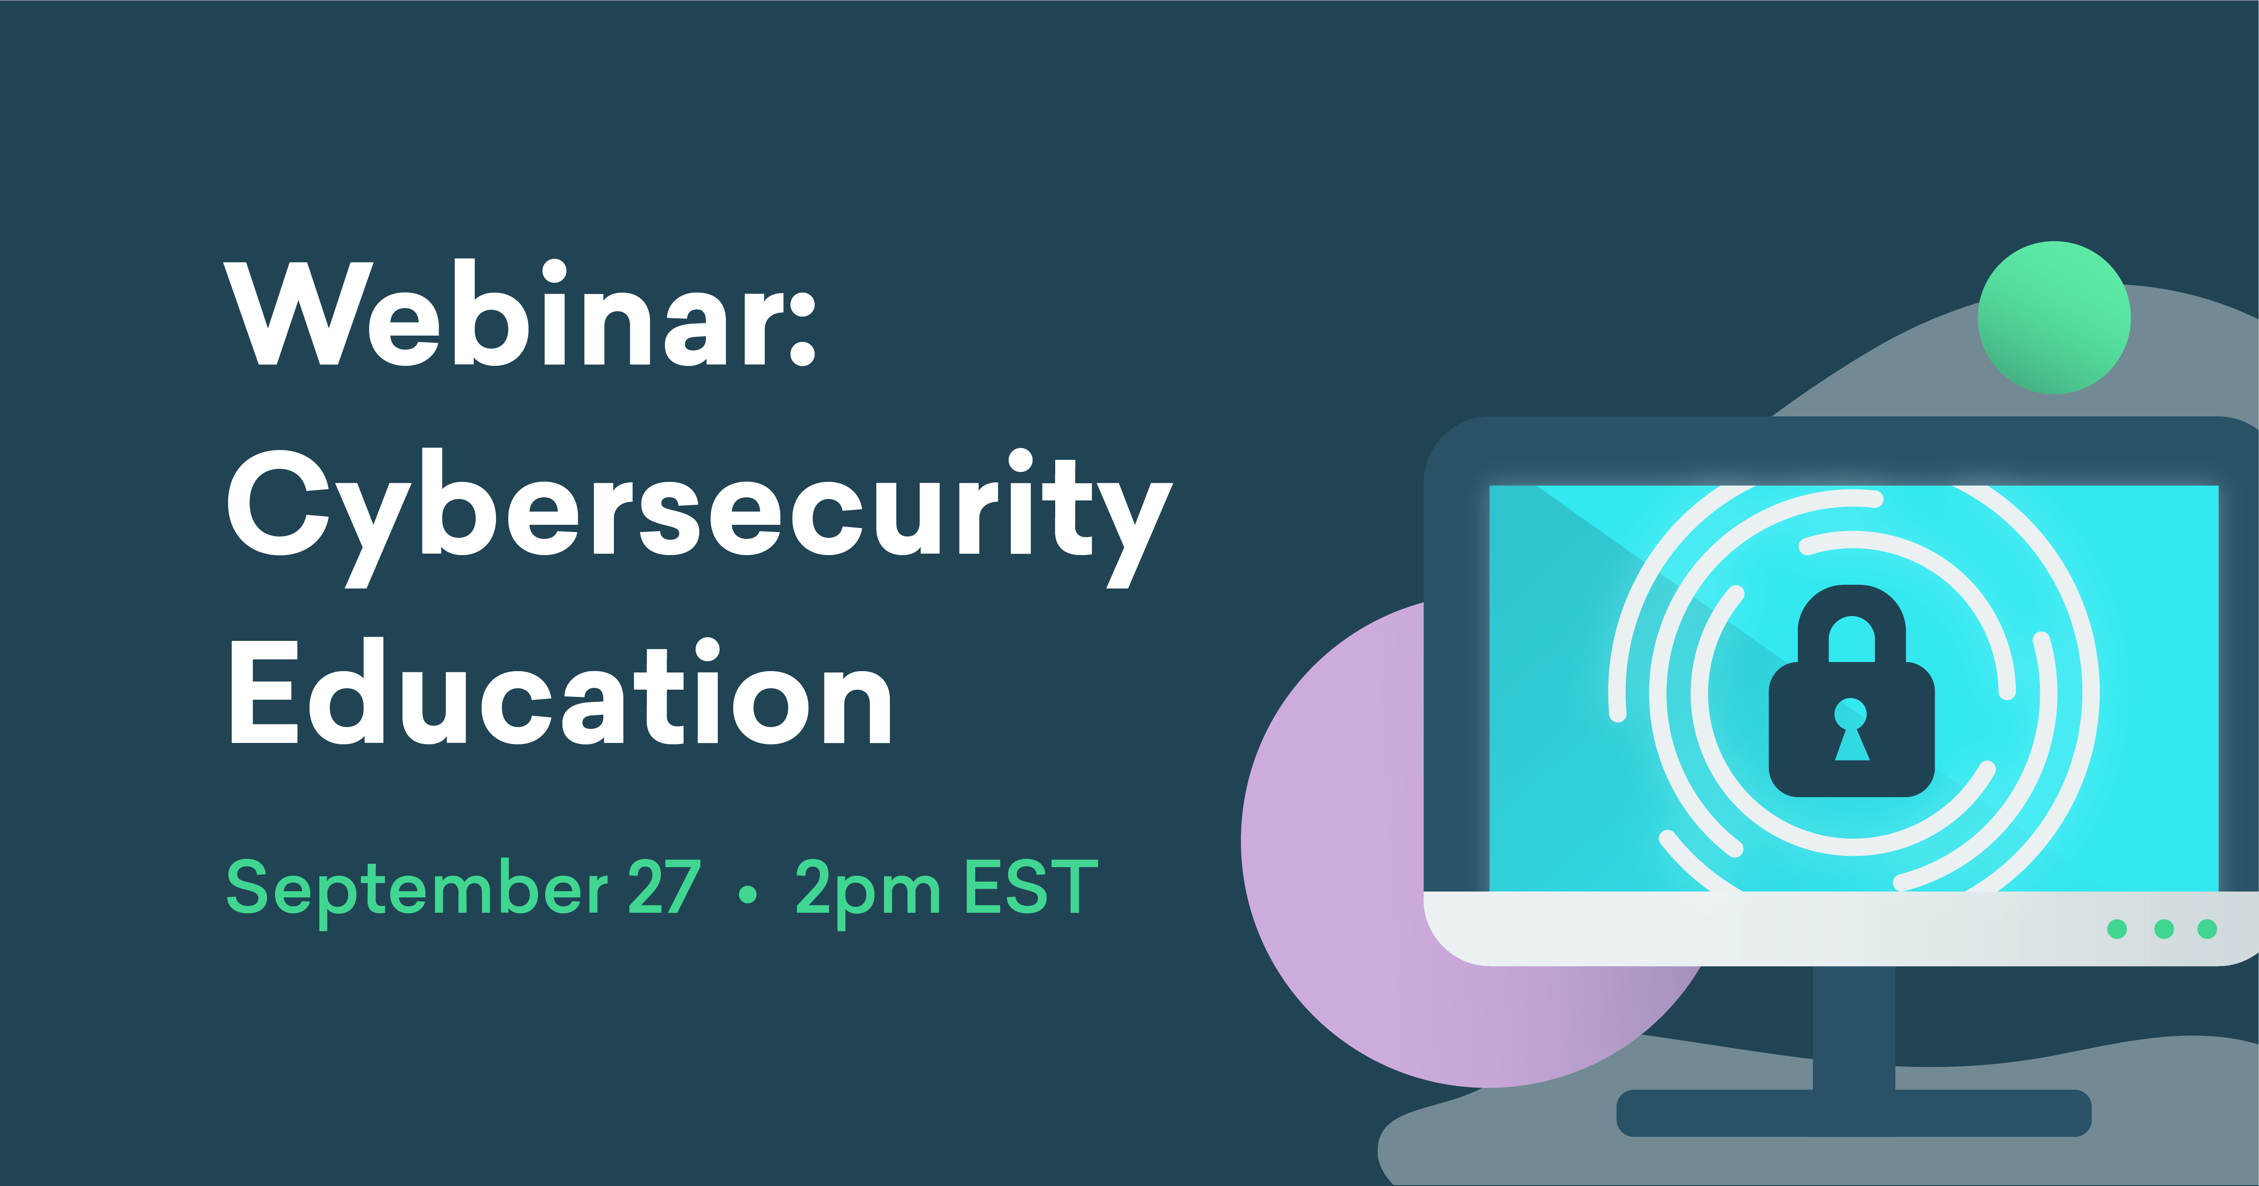
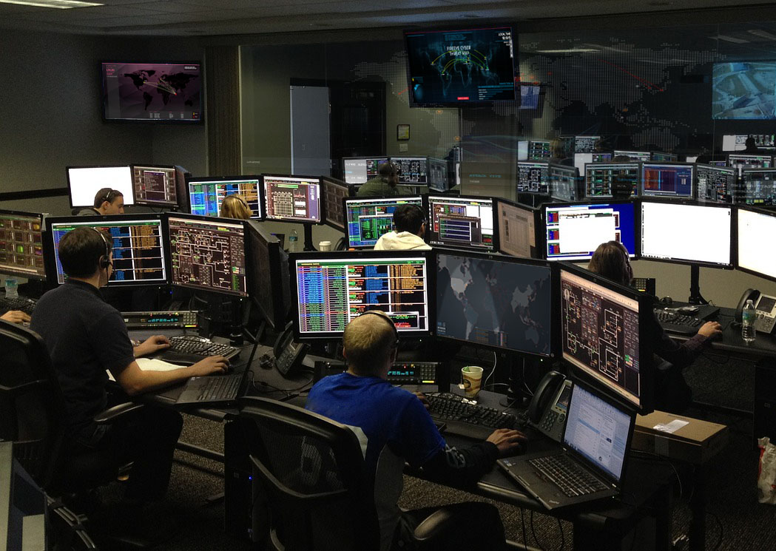
We Are Solving a Critical Industry Problem
Cyber Defense Teams are Not Prepared for an Attack
SANS Courses
Tabletop Exercises
Labs
On the Job
Do Not Reflect the Real World
No hands-On Practice
Only Fractions of the Attack; No Teamwork and Soft Skills
Too Little, Too Late

Slide 5
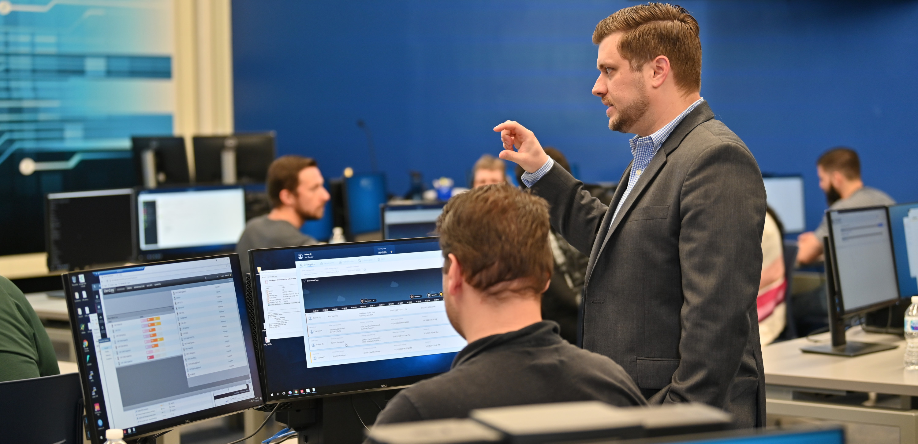
Cyberbit Range
The First Hyper-Realistic
Training Platform
Play Testimonials
5

Slide 6
































The Most Widely Used Cyber Range
Major Police Dept.
Top-3
US Airline
Top-5
US Bank
Top-3
US Airport
Top-5
US Airline

Slide 7













Massive Growth over last 12 Months
100%
ARR Lift
100%
Customer Base Increase

Slide 8
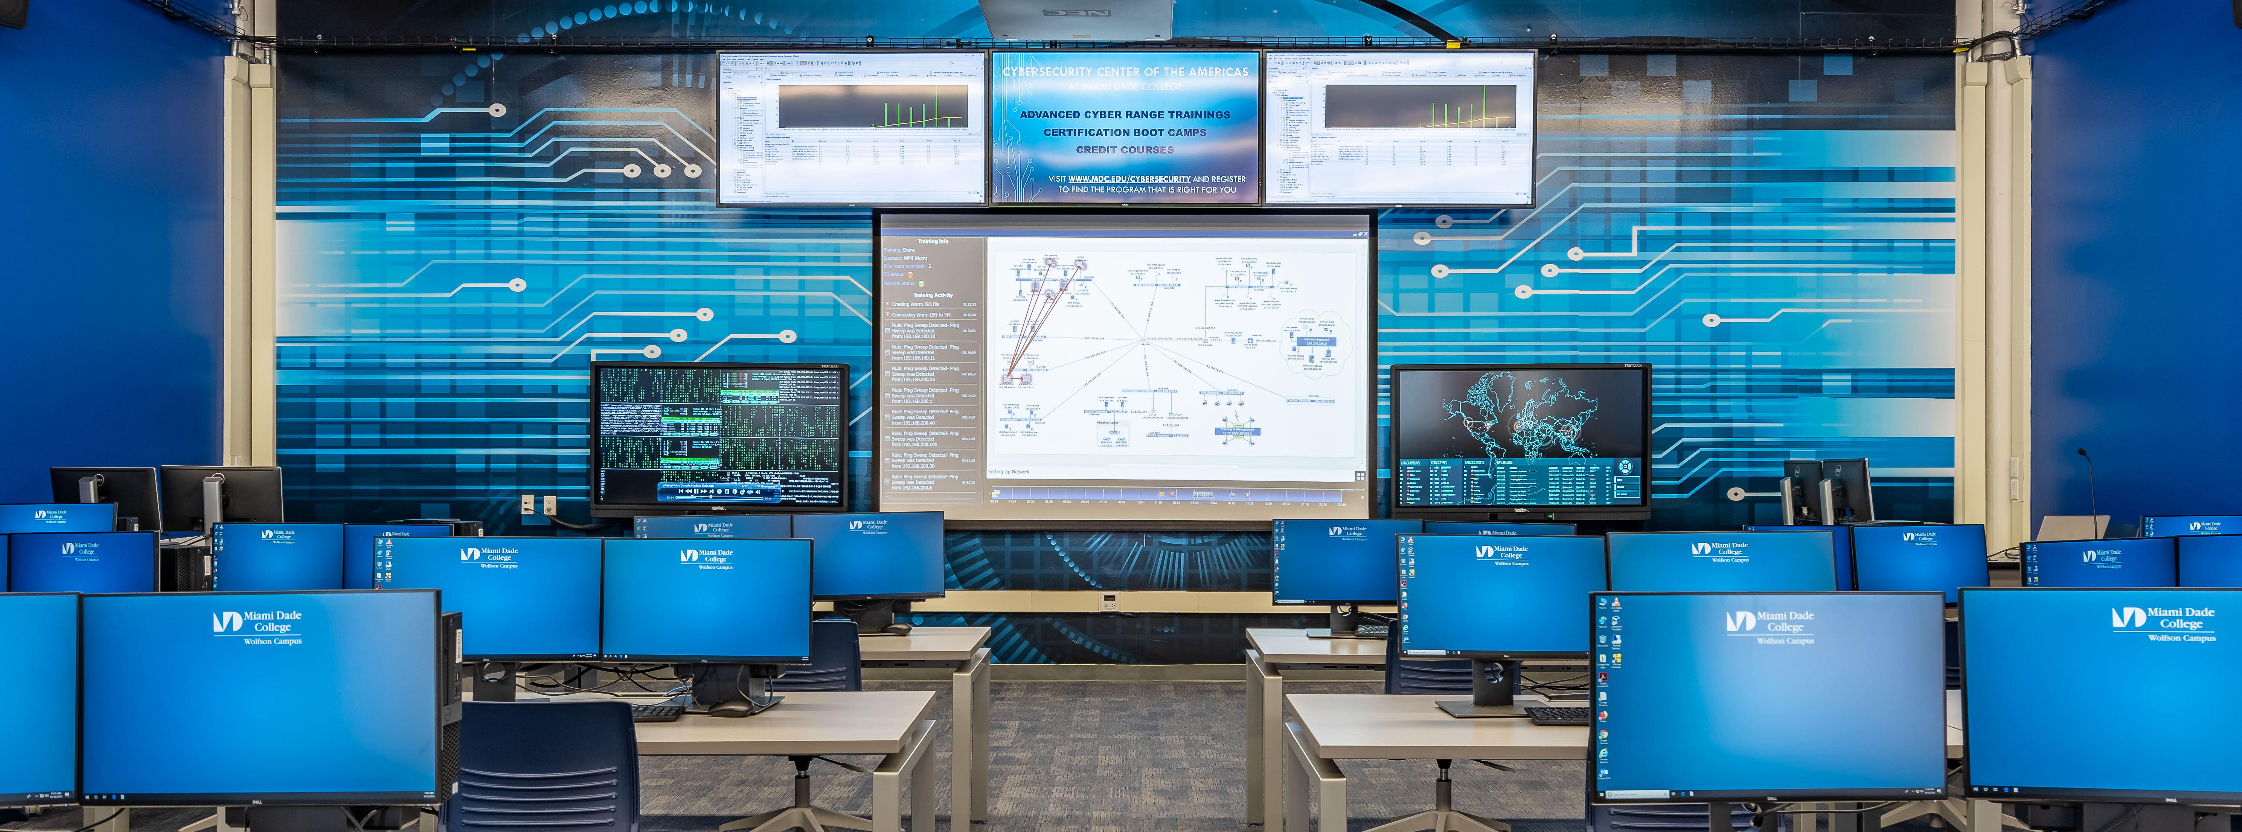
Dozens of New Cyber Range Facilities
Cybersecurity Center of the Americas
Miami Dade College
Notes:
This is one of our cyber ranges at Miami Dade college, the largest undergraduate

Slide 9





Real World Attacks, Networks and Tools
Instructor (optional)
Virtualized Corporate Network
Over 60 Components
Automated Attack Generator
Traffic Generator
Simulated
internet
Web Server
User PC
Firewall
Email Server
Proxy Server
Firewall
Router
User PC
Desktop Linux
Switch
Bridge
Switch
Database
Advanced SOC Training Scenarios
Entry-Level SOC Training Scenarios
Advanced SOC Training Scenarios
Pentesting Training Scenarios
Virtualized SOC
Real-World Tools
9

Slide 10
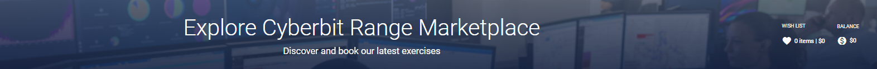

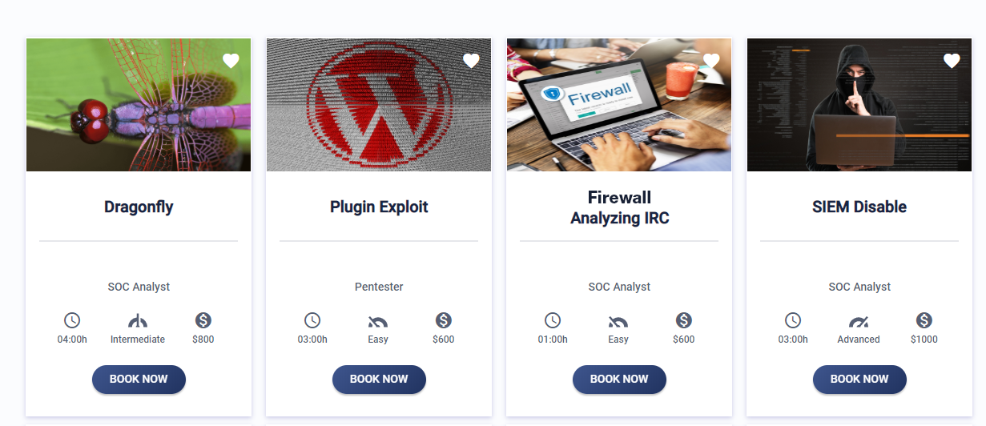
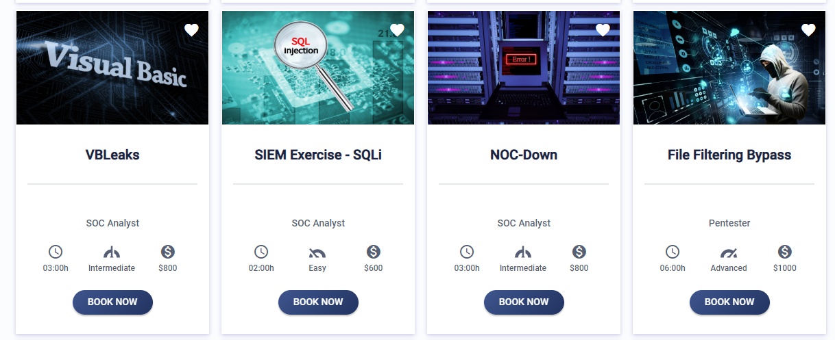
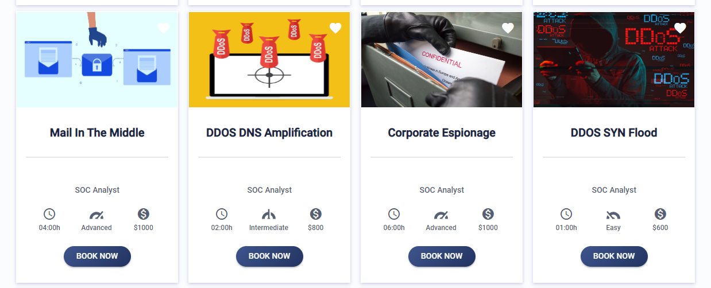
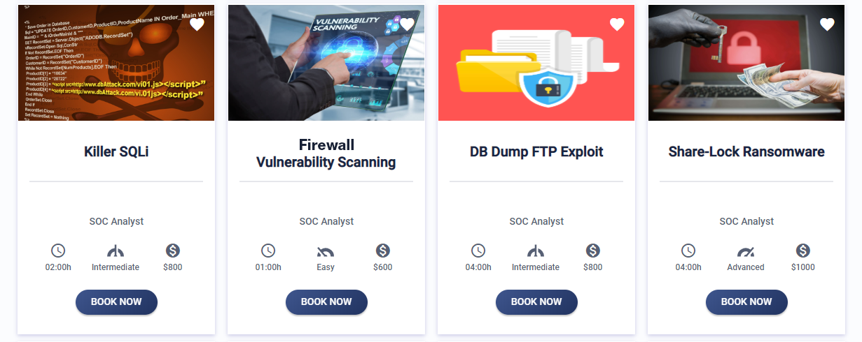
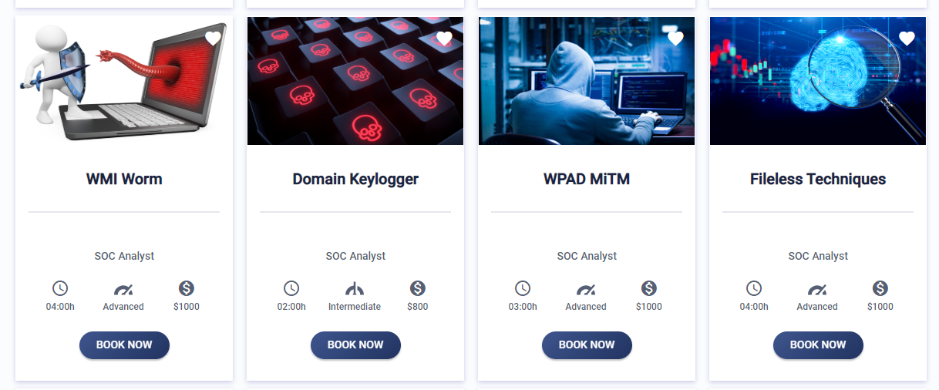
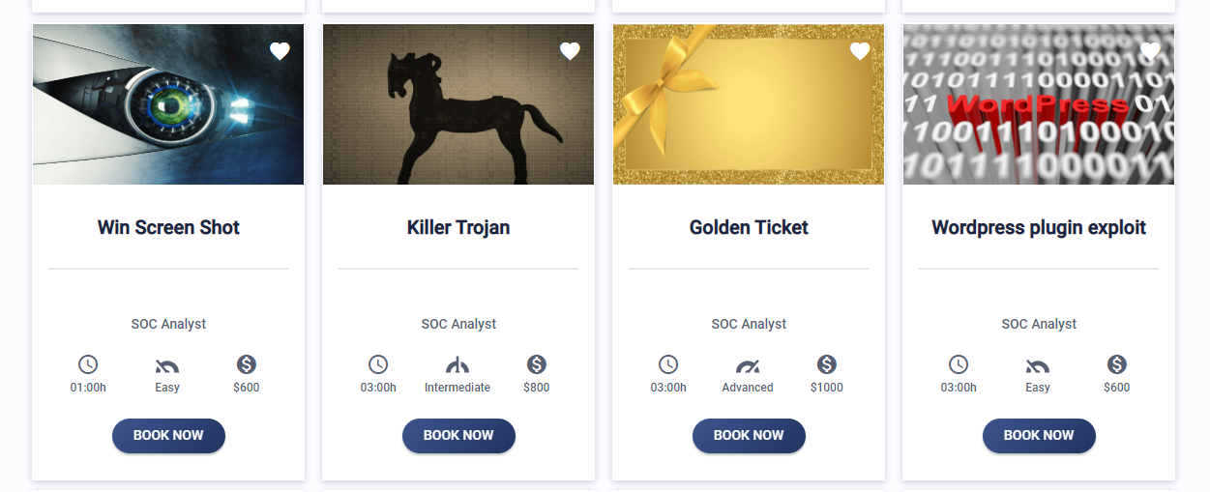
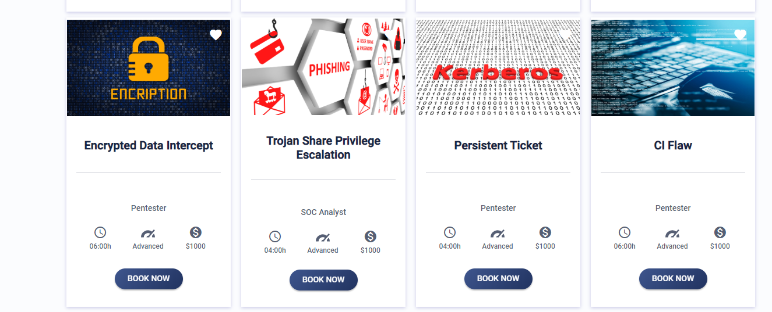
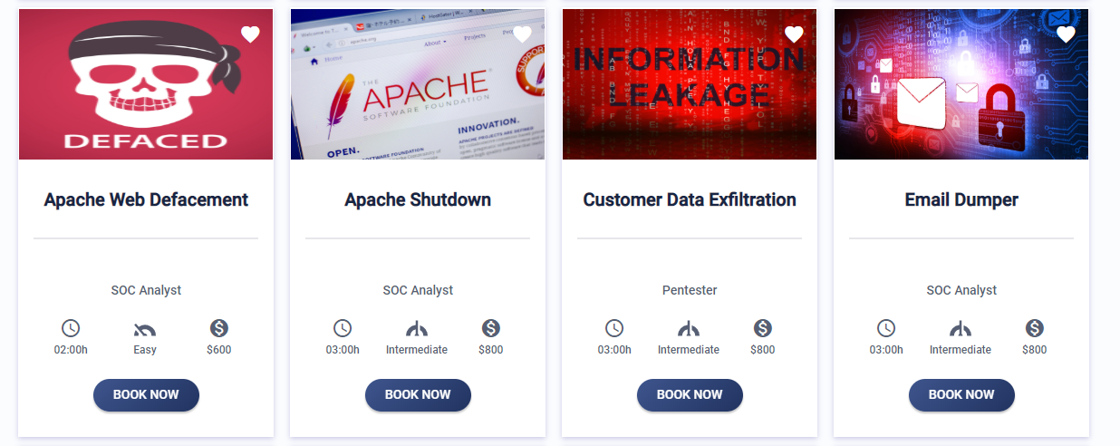
Dozens of Simulated Cyber Attacks that Prepare Your Team
Multiple Training Exercises

Slide 11


On-Prem and Cloud Models
Cyberbit Cloud Range
Cyberbit On-Prem Range
Cyber range
as–a- service
Instant Access, Anytime, Anywhere
AWS Hosted
Customize networks & tools
Customize
scenarios
Practice OT
attacks
11
Notes:
You have 2 options to use the range. One is to access our cloud range on AWS. It’s instant access – so you log in and start training.
The other option is buying an on-prem range. What’s unique about it is that besides all the great capabilities of the cloud range you can customize the network and the scenarios, so you can, for example, use your own SIEM brand and configure the infrastructure to mirror yours. Let’s discuss the difference between the 2 options.

Slide 12

Customizable to Fit Client Needs
Instructor Tools
Attack Generator
Virtualized Network
Traffic Generator
Simulated
internet
Web Server
Firewall
Web Server
User PC
Network Import
Scenario Pro
Bridge
Switch
User PC
Switch
User PC
Desktop Linux
Email Server
Database
Database
Web Server
Web Server
Virtualized SOC
Router
Firewall

Slide 13
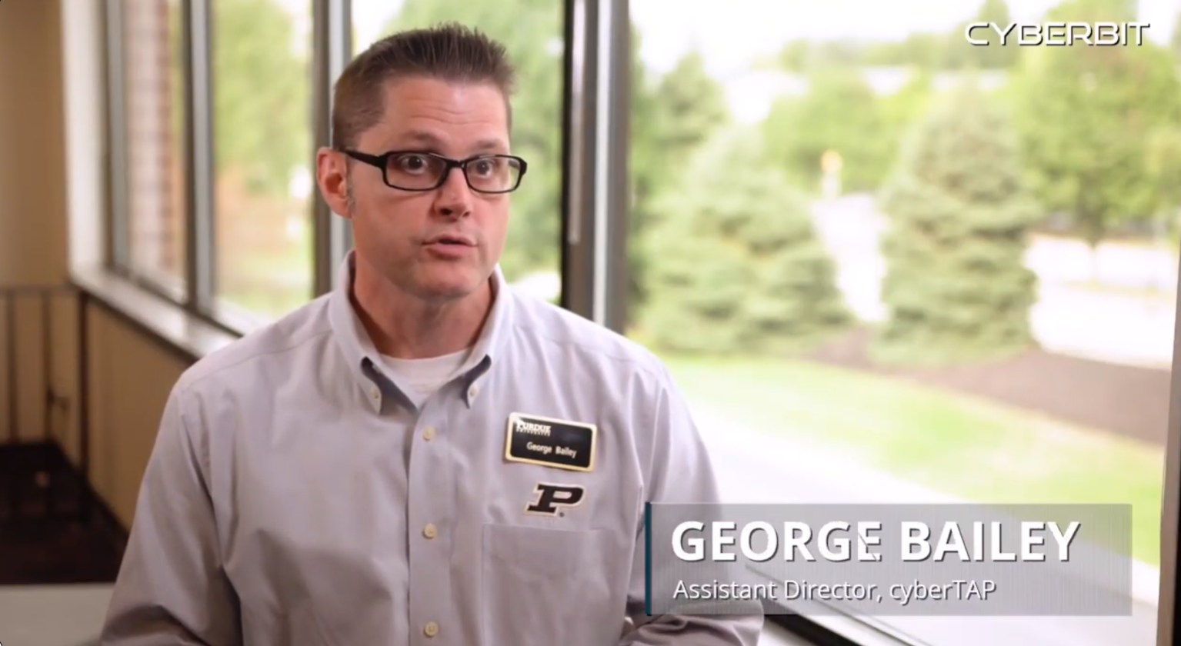
Hear it from Purdue University
Play Testimonial
13

Slide 14


Good Luck!

